Slide 1
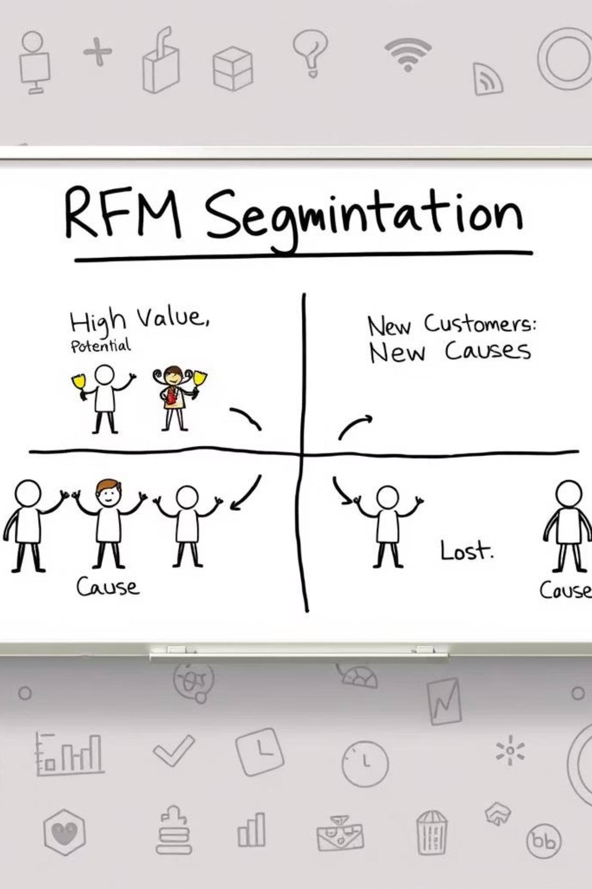
RFM Segmentation and Customer Insight Analysis
By Saubhagya Monal

Slide 2
Problem Statement
Urban retail struggles with challenges like inventory management, customer engagement, and secure online transactions. Traditional systems often fail to meet modern expectations for convenience and transparency.
To address this, a data-driven approach using RFM (Recency, Frequency, Monetary) segmentation is essential enabling smarter customer analysis and strategic marketing decisions.
This presentation will cover the full customer data lifecycle, from cleaning and processing to segmentation and actionable insights.

Slide 3
Methodology
Data Collection & Cleaning: Loaded dataset using Pandas, parsed dates, handled nulls, standardized column types.
RFM Calculation: Calculated recency (days since last purchase), counted frequency (number of purchases), summed Monetary (total amount spent).
RFM Scoring: Used quantiles to assign scores (1–4) for each R, F, M metric.
Segmentation: Combined RFM scores to classify customers into segments.
Visual Analysis: Created multiple plots for distribution, segment revenue, product patterns, seasonal insights.

Slide 4
Dataset Overview
In the data the following details are present :
CustomerID: A unique identifier for each customer.
PurchaseDate: The date when a purchase was made, used to calculate the recency of customer transactions.
TransactionAmount: The amount of money spent in each transaction, used to calculate the monetary value of customers.
ProductInformation: Details about the products purchased, useful for analyzing product preferences.
OrderID: A unique identifier for each order, useful for tracking individual transactions.
Location: The geographical location where the purchase was made, useful for analyzing regional sales patterns.

Slide 5
About RFM
RFM is a marketing analysis tool used to identify a company's best customers based on three quantitative factors:
Recency (R): How recently a customer made a purchase.
Frequency (F): How often a customer makes a purchase.
Monetary (M): How much money a customer spends on purchases.
RFM analysis helps businesses understand customer behavior, segment their customer base, and tailor marketing efforts to different customer segments. Each of the three RFM components is scored individually to create a composite RFM score for each customer.

Slide 6

Data Collection & Cleaning
Handled missing values and verified data types.
Parsed PurchaseDate correctly into datetime format.
Ensured data is clean and ready for RFM computation.
Confirmed unique customers and order consistency.

Slide 7
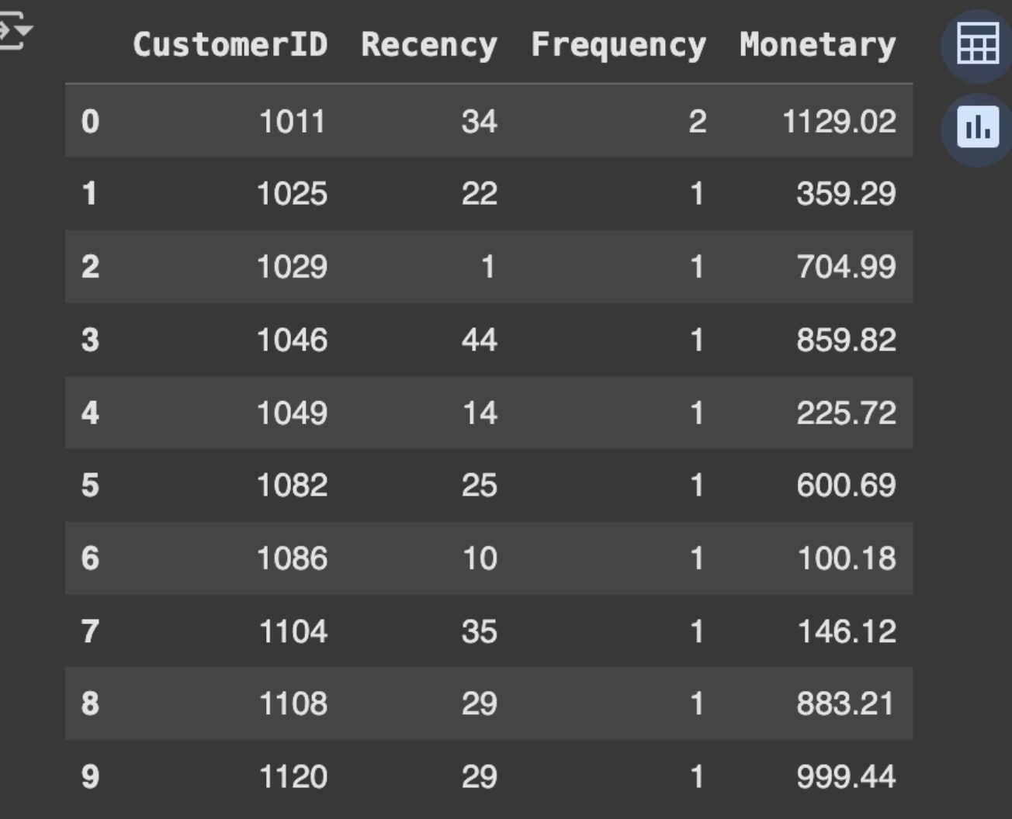
Calculation of RFM Metrics
Recency: Days since last purchase from the reference date.
Frequency: Number of unique orders per customer.
Monetary: Total amount spent per customer.
Created rfm_df with CustomerID, Recency, Frequency, Monetary.

Slide 8
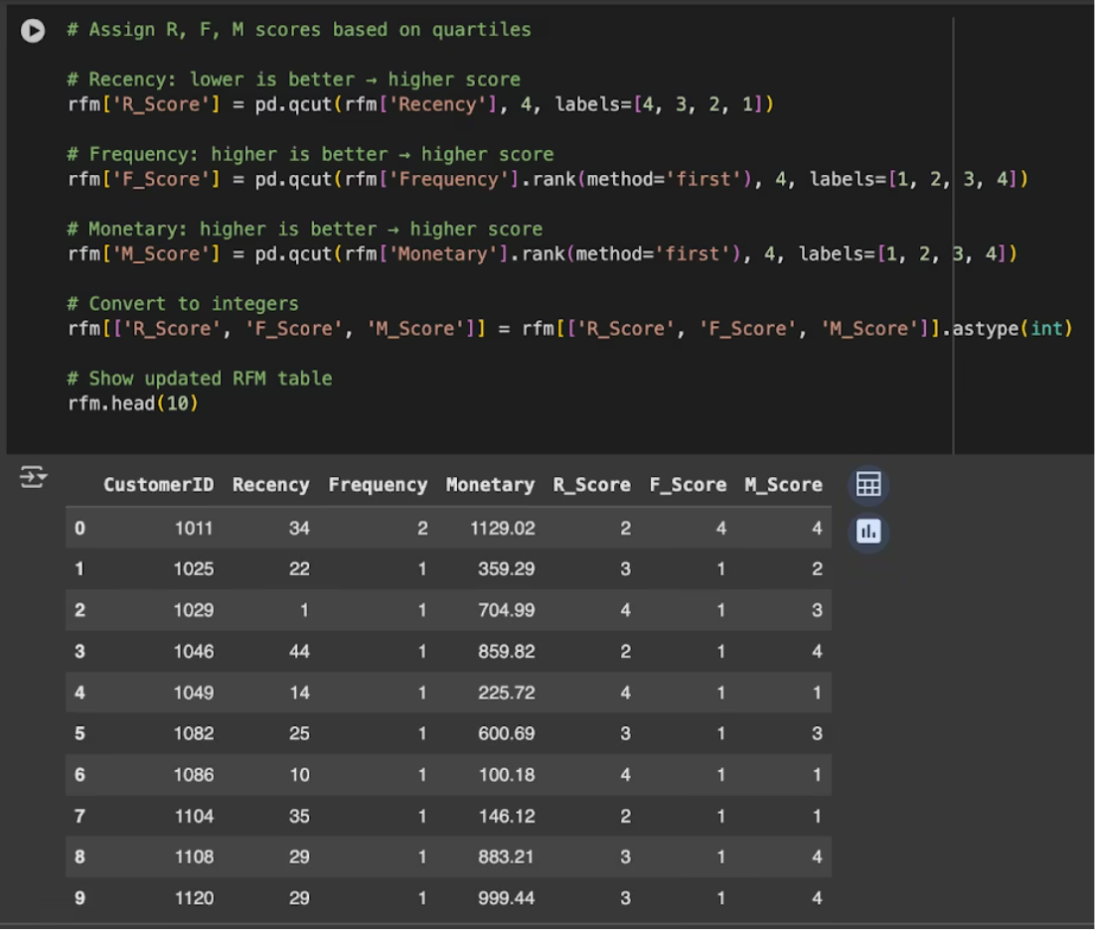
Assign Scores to the RFM Values
Scored each customer from 1 to 4 for R, F, and M based on quartiles
Higher Recency → Lower score (recent = better)
Higher Frequency & Monetary → Higher score
Created additional columns: R_Score, F_Score, M_Score

Slide 9
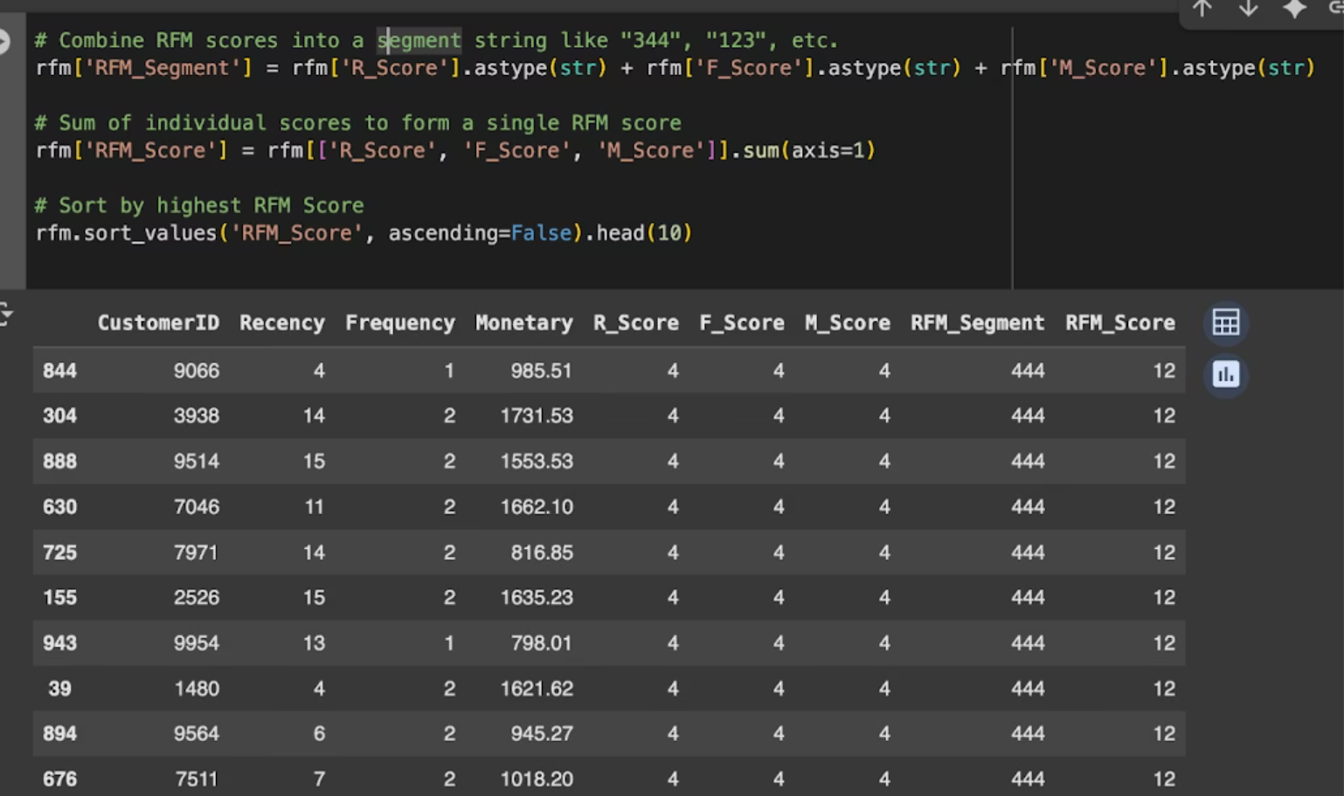
Create RFM Segments
Concatenated scores to form RFM_Segment (e.g., 444, 311)
Calculated RFM_Score = R + F + M
Used custom logic to classify customers into:
Champions
Loyal & High Spenders
Big Spenders
Loyal
Others
At Risk
New Customers
Lost

Slide 10
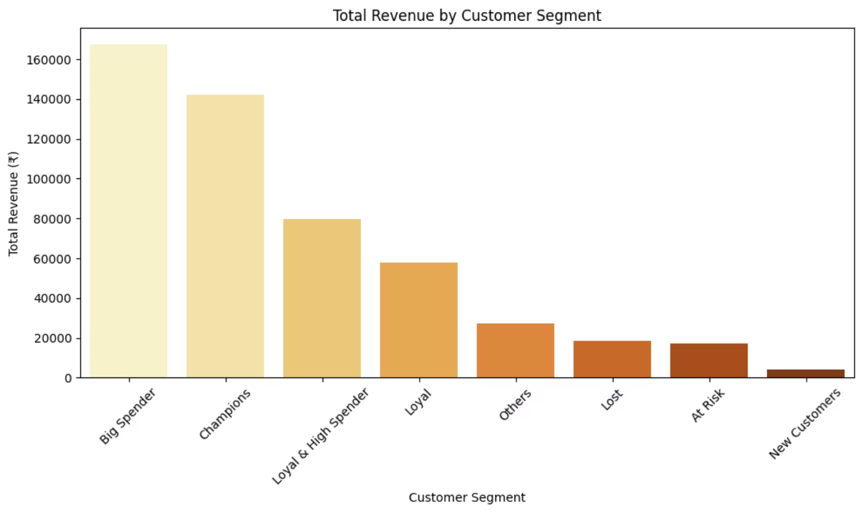
Revenue Contribution by Segment
Segments with highest revenue:
Big Spender: ₹167K
Champions: ₹142K
Loyal & High Spender: ₹79K
Lower revenue from:
Lost: ₹18K
New Customers: ₹3.9K
Big Spenders and Champions alone contribute >50% of total revenue, highlighting their importance to business sustainability.
Loyal & High Spenders also make a significant impact; these are customers worth retaining.
Lost and At Risk segments contribute less, indicating reduced engagement or churn.

Slide 11
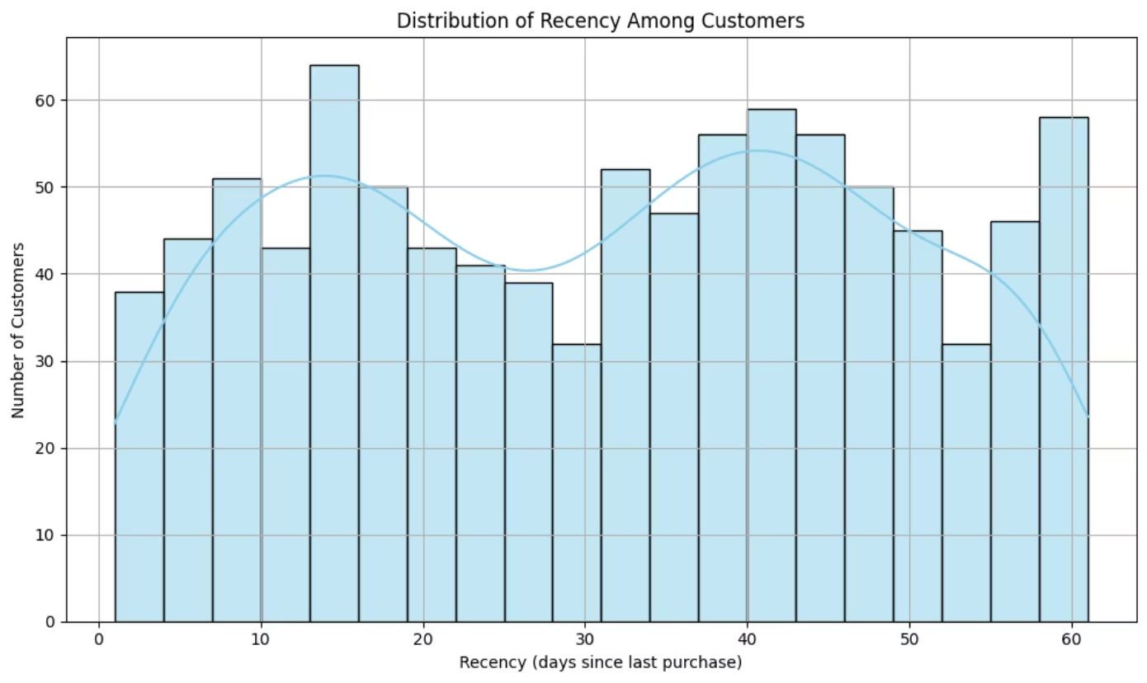
Recency Distribution
The histogram shows that a significant number of customers made recent purchases (lower recency), indicating active engagement. A long tail suggests some customers haven't purchased in a long time, which may need reactivation campaigns.

Slide 12
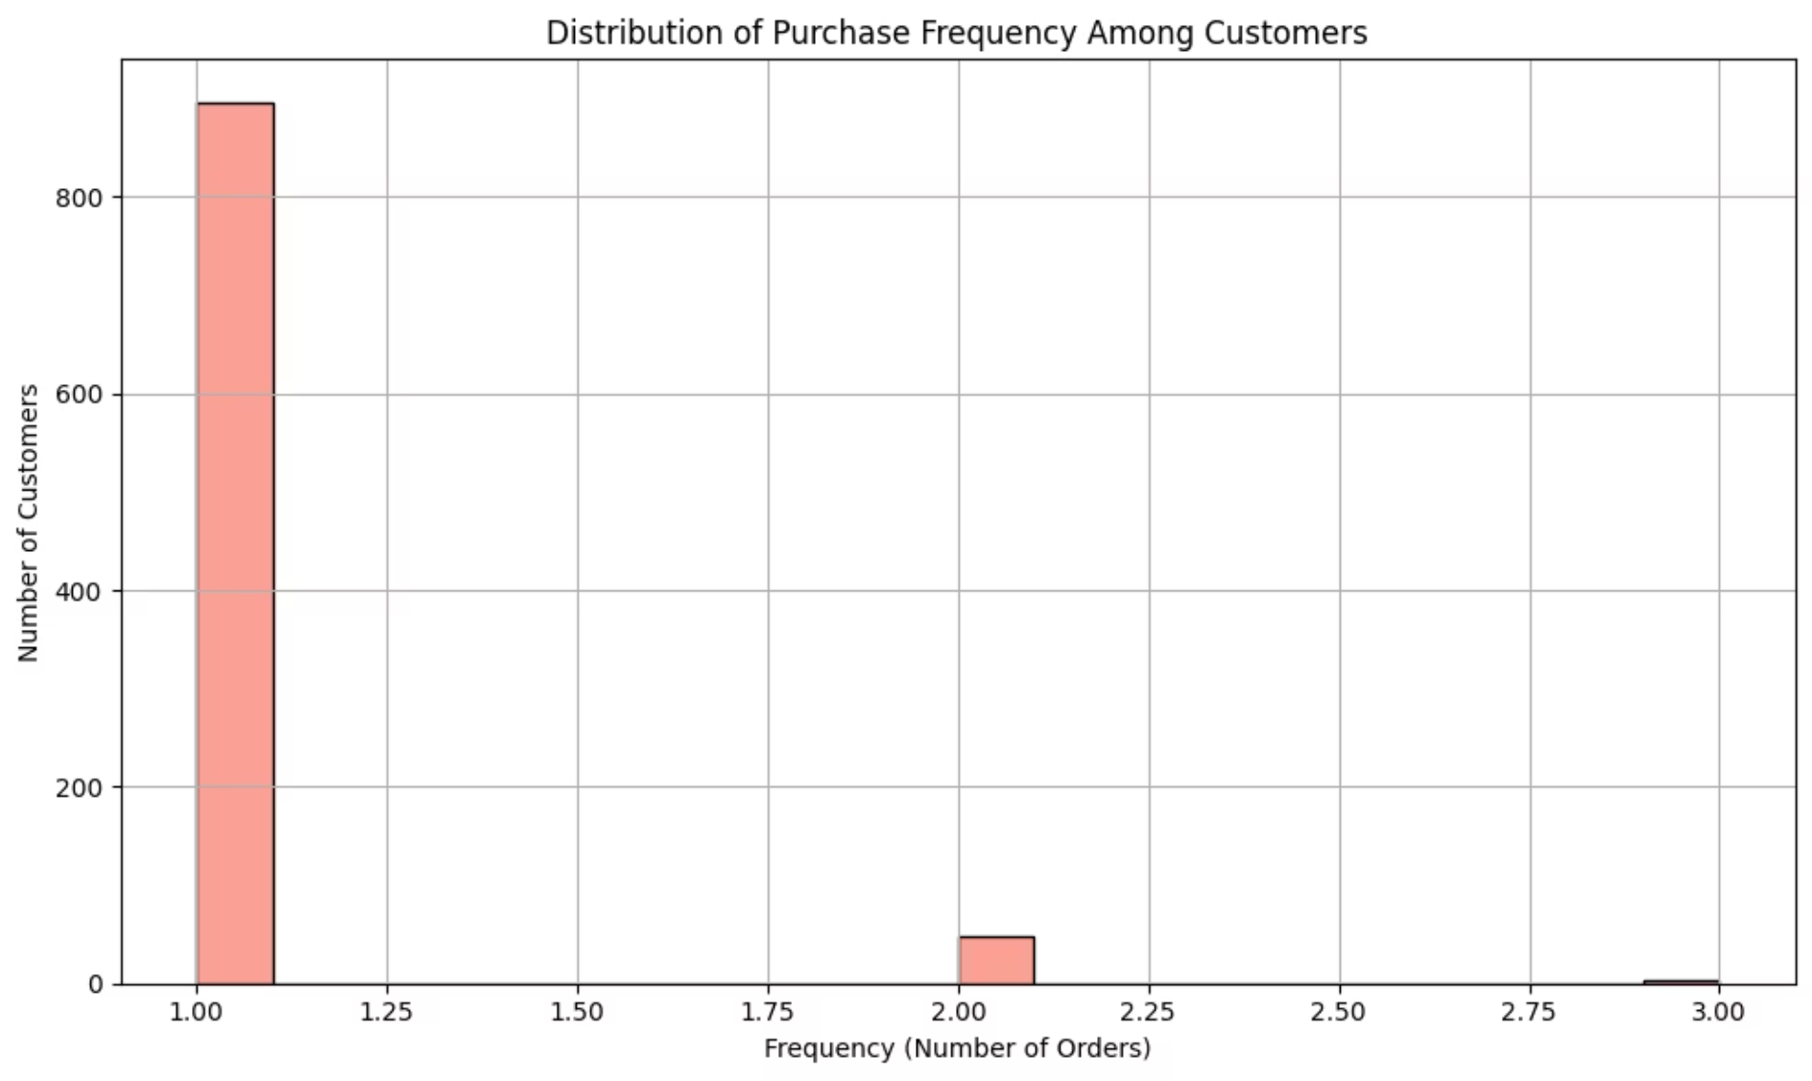
Frequency Distribution
Most customers have a low purchase frequency, which is expected in many businesses where casual buyers dominate.
However, a few customers show much higher frequency, representing a valuable group that may be highly loyal or engaged.

Slide 13
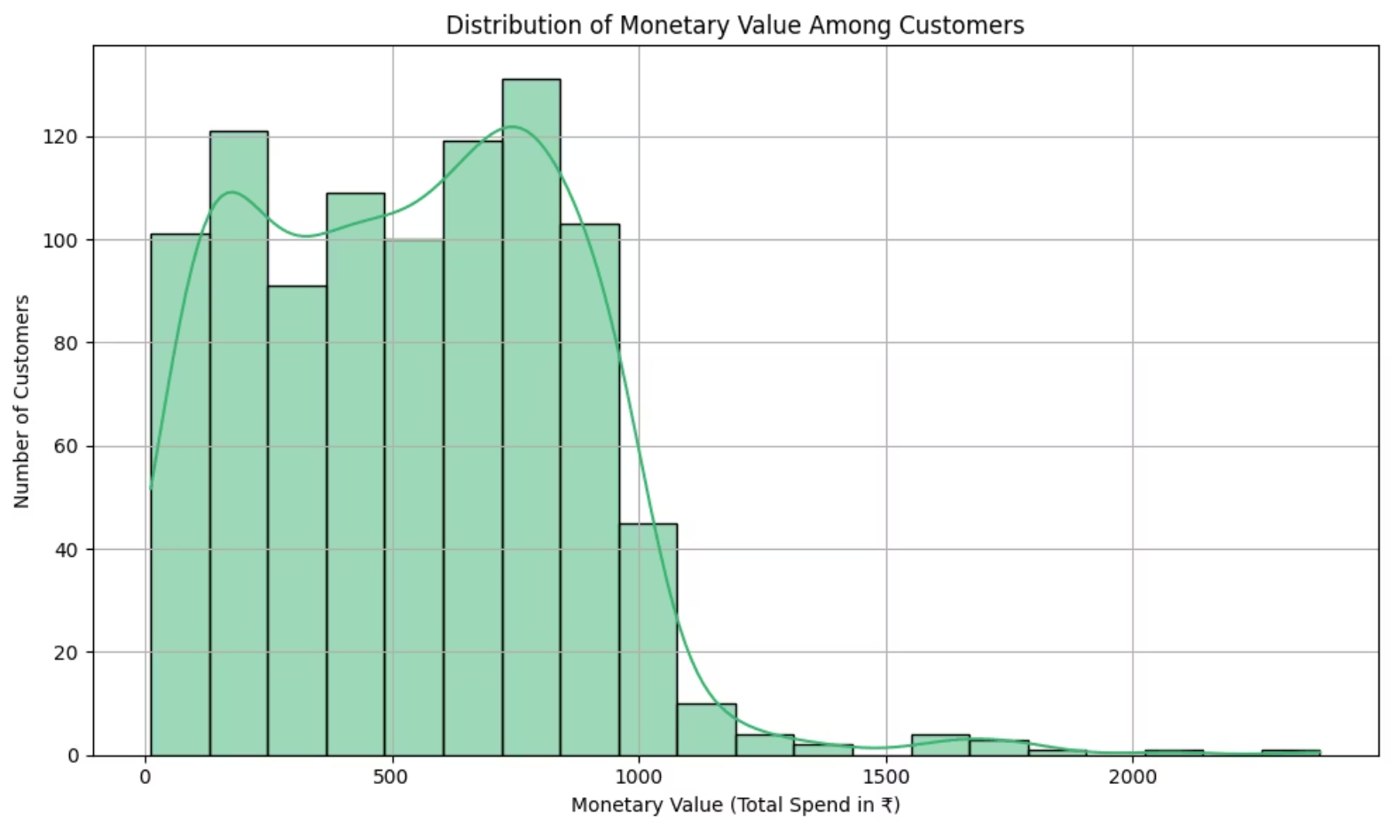
Monetary Value Distribution
The histogram indicates that most customers spend a relatively low amount, while a small group contributes very high monetary value highlighting the importance of high spenders (e.g., "Big Spender" and "Champions" segments).
These are the customers that drive most of the revenue and should be prioritized.

Slide 14
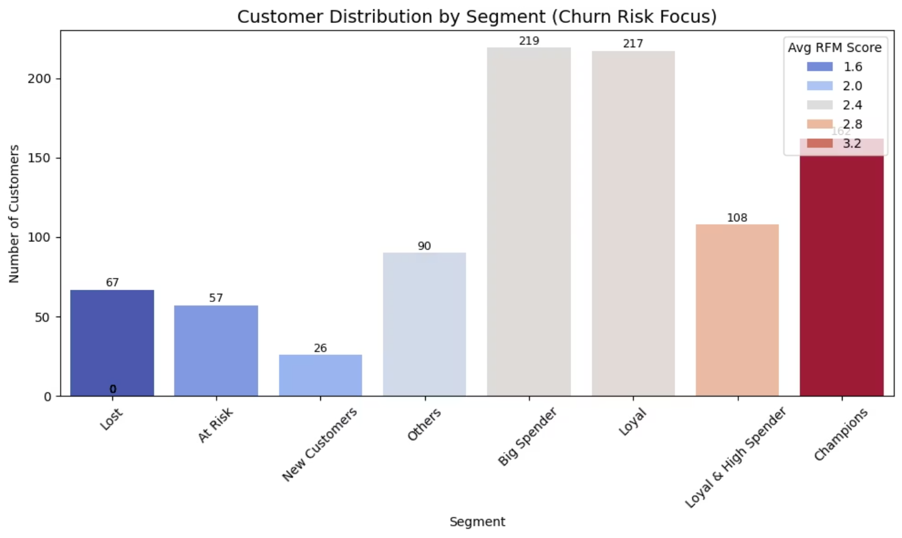
Identifying Low RFM Segments (Churn Risk)
Low RFM segments: Lost, At Risk
Low average scores: ~1.3 to 1.6
Retention Strategy:
Offer reactivation discounts
Send personalized re-engagement messages
Time-limited offers to create urgency

Slide 15
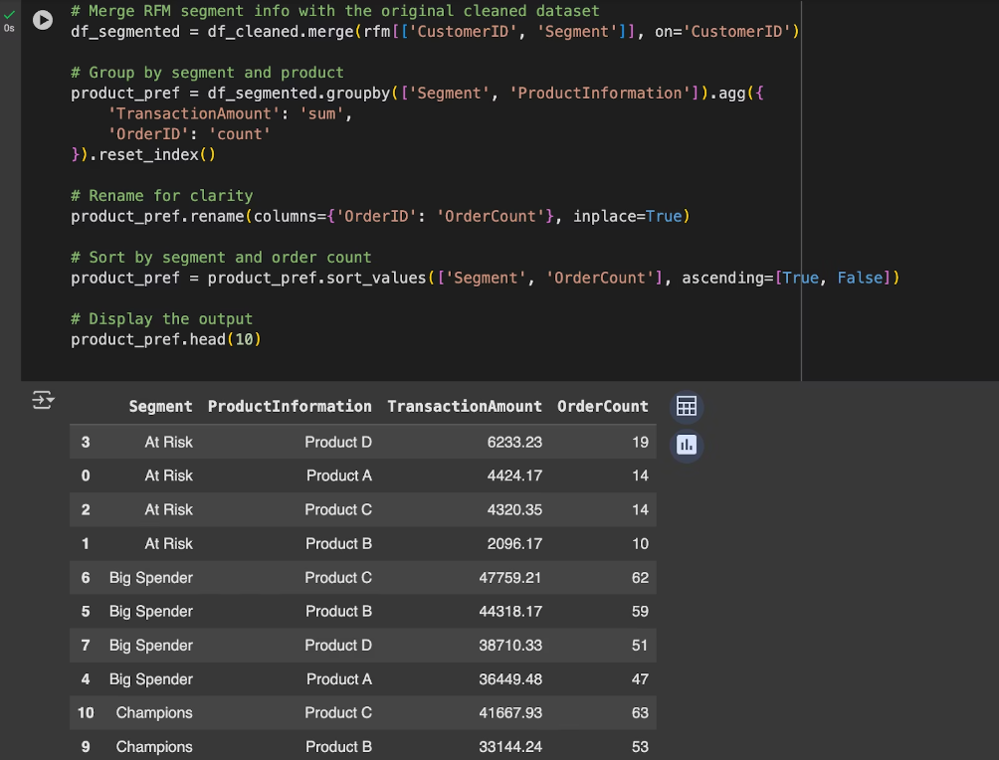
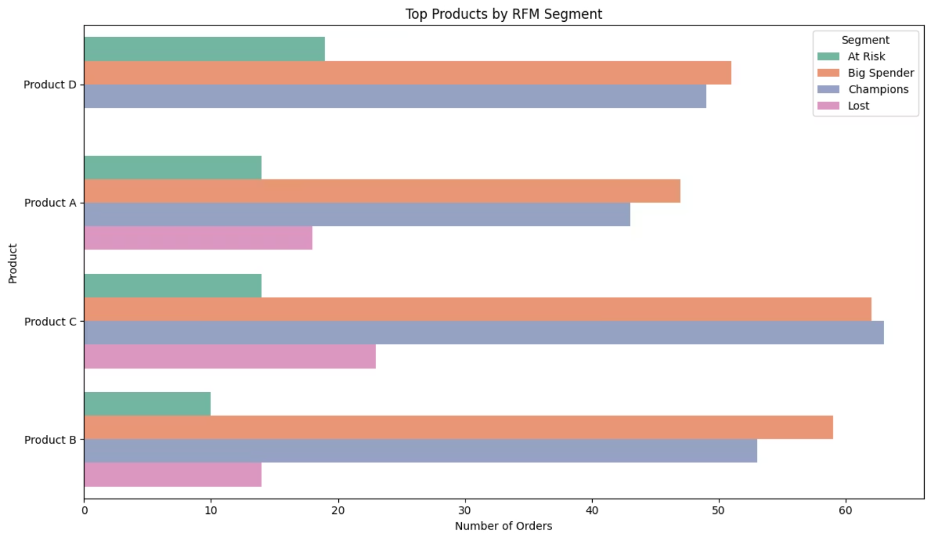
Product Preferences by Segment
Top products:
Champions prefer Product C and B
Big Spenders purchase all 4 products with high volume
At Risk still show interest in Product D
Product Development:
Improve features of Products B and C
Reposition Product D to reduce churn

Slide 16
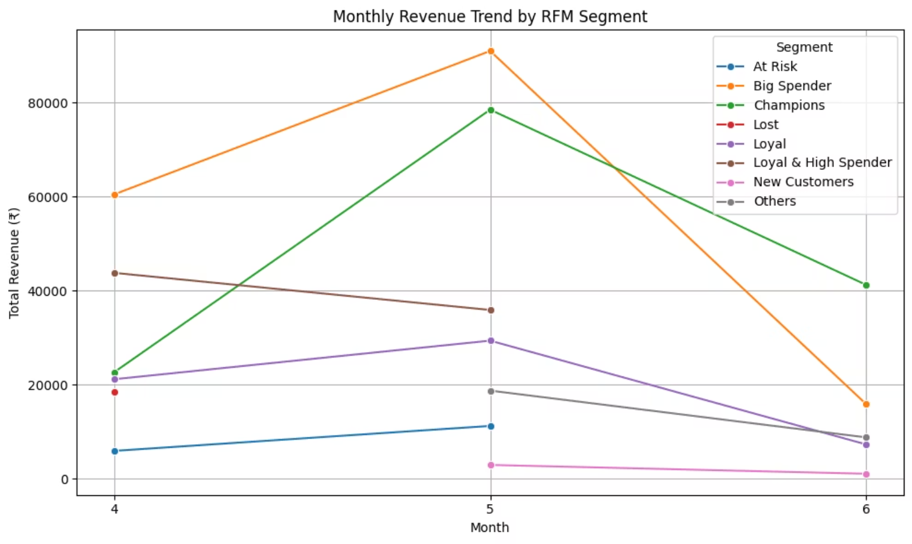
Seasonal Trends
Peak revenue in May across all segments
Champions & Big Spenders bought more in May and June
Seasonal Campaigns:
Run flash sales during peak periods (May–June)
Plan new product releases before summer
Pre-summer loyalty campaigns

Slide 17
Conclusion
This RFM-based Exploratory Data Analysis successfully segmented the customer base into distinct behavioral groups using Recency, Frequency, and Monetary metrics.
The analysis revealed that Champions, Big Spenders, and Loyal & High Spenders contribute significantly to the overall revenue. These segments exhibit high purchasing frequency and monetary value, making them prime candidates for premium and loyalty-driven campaigns.
Product analysis uncovered strong cross-selling opportunities, particularly with combinations like Product A & C and Product D & B. Segment-wise preferences indicate room for product improvement, targeted bundles, and inventory prioritization.
Seasonal trends showed peak revenue in May and June, especially from high-value segments. Marketing efforts should align with these periods to maximize ROI through seasonal promotions and early-bird incentives.

Slide 18
Recommendations
RFM segmentation effectively identified strategic customer clusters
Top 3 Revenue Segments: Champions, Big Spenders, Loyal & High Spender
Priority Actions:
Personalize campaigns by segment and timing
Focus efforts on Tokyo, NY, and London
Strengthen cross-sell and bundle offerings
Encourage repeat purchases through loyalty systems

Slide 19
Reference
Data : Newton School
Applications Used: Google Colab, MS Word, MS Power Point.

